Slide 1
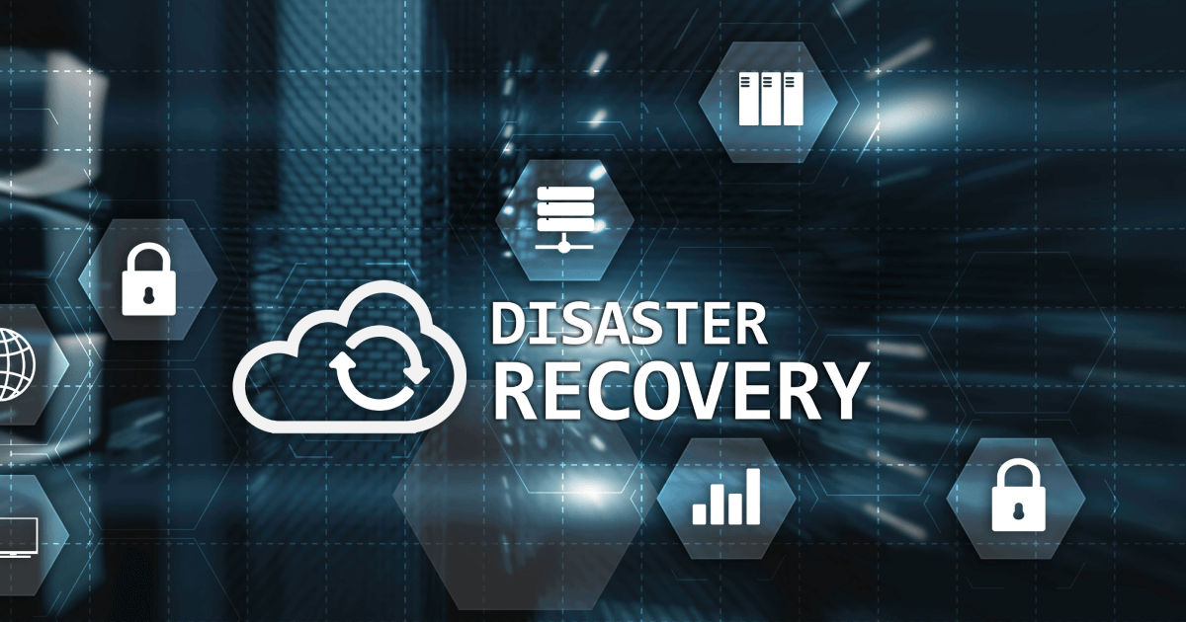

Slide 2

Presentation by
R . Harish
S . Naveenkumar
S . Vasanthavel
C . Dhinesh
D . Surya

Slide 3
What is Disaster Recovery Strategy ?
A disaster recovery strategy is a comprehensive plan that an organization develops to minimize the impact of unexpected disasters, such as natural disasters, cyberattacks, hardware failures, or other disruptive events. It outlines the procedures and technologies required to recover and restore critical systems, data, and operations after a disaster. The primary goals of a disaster recovery strategy are to ensure business continuity, minimize downtime, and safeguard essential data and resources. This strategy typically includes backup and data recovery solutions, off-site data storage, redundancy in IT infrastructure, and predefined processes for response and recovery in the event of a disaster.
+

Slide 4
Disaster Recovery Include RTO:
A disaster recovery strategy includes RTO, which stands for Recovery Time Objective. RTO is the targeted duration within which a business process or system must be restored after a disruption to avoid unacceptable consequences. It helps organizations set goals for how quickly they need to recover their IT systems and data after a disaster. Having a well-defined RTO is a critical aspect of disaster recovery planning to ensure the timely resumption of operations in the event of a disaster.

Slide 5
Disaster Recovery Inlcude RPO:
A disaster recovery strategy also includes RPO, which stands for Recovery Point Objective. RPO is a crucial parameter that defines the acceptable amount of data loss that an organization can tolerate in the event of a disaster. It helps determine how frequently data needs to be backed up to ensure that, in the event of a disruption, the organization can recover to a point in time that is acceptable from a data loss perspective. RPO, along with RTO (Recovery Time Objective), guides the development of a comprehensive disaster recovery plan that outlines how quickly data can be recovered and at what point in time it can be restored.

Slide 6
Priority Of Virtual Machines:
The priority of a virtual machine (VM) can be influenced by several factors, but it's typically determined by the hypervisor or virtualization platform on which the VM is running. Priority management can be important for resource allocation and performance. Here are some key factors that can influence VM priority:

Slide 7
Resource Utilization: VMs that are actively using their allocated resources might be given higher priority than those that are idle.
Service Level Agreements (SLAs): In enterprise environments, VM priority may be based on SLAs. VMs supporting critical applications may have higher priority to ensure they receive the necessary resources to meet performance expectations.
Affinity Rules: Hypervisors often allow you to set affinity rules that prioritize VMs on certain host servers. This can influence which VMs get resources in cases of resource contention.
Dynamic Resource Allocation: Some hypervisors allow for dynamic resource allocation based on real-time performance metrics. VMs in need of additional resources might be given higher priority during resource allocation.
Manual Configuration: Administrators can manually set priorities for VMs in some virtualization platforms, determining which VMs should be given preference in resource allocation.

Slide 8
Virtual Machine Using Backup Tools Or Script
Creating a virtual machine using backup tools and scripts typically involves a multi-step process. Here's a high-level overview of how you can achieve this:
Backup Your Existing Machine:Use backup tools like Veeam, Acronis, or built-in solutions (e.g., Windows Backup) to create a backup of your existing machine. Ensure that the backup is in a compatible format, such as VHD or VMDK.
Select a Hypervisor:Choose a virtualization platform (hypervisor) to host your virtual machine. Popular options include VMware, VirtualBox, Hyper-V, and KVM/QEMU.

Slide 9
Set Up the Hypervisor:Install and configure the chosen hypervisor on your target machine.
Create a Virtual Machine:Using the hypervisor's management interface, create a new virtual machine.
Specify Virtual Machine Settings:Configure settings such as CPU, memory, storage, and network for the virtual machine.
Import Backup into Virtual Machine:Depending on your hypervisor, you can either directly use the backup file or convert it to a format compatible with the hypervisor.
Install Operating System:If the backup doesn't include the OS, you'll need to install the operating system on the virtual machine.
Start the Virtual Machine:Boot up the virtual machine and ensure it's working correctly.

Slide 10
Customize and Fine-Tune:Depending on your needs, customize the virtual machine by installing additional software, adjusting configurations, and applying any necessary scripts.
Automate Using Scripts (Optional):You can use scripts to automate parts of this process. For example, you can script the import of the backup, OS installation, and software configurations.
Test and Verify:Before using the virtual machine for production purposes, thoroughly test it to ensure everything works as expected.
Backup the Virtual Machine:After creating the virtual machine, it's crucial to set up regular backups within the virtualization environment to safeguard your VM's data and configurations.

Slide 11


